Slide 1
SHOPRITE 2023/2034 SALES PERFORMANCE PRESENTATION Batch 2 group 3

Slide 2
agenda
Introduction
Data Collection
Data Cleaning
Formatting
Vlookup
Application of functions (AUTOSUM,SUMIF,AVERAGEIF)
Charts
Dashboard
Summary

Slide 3

INTRODUCTION TEAM MEMBERS
Lawal Abdul-Azeez Ademola
Ogbugo Grace Nnena
Ogunbunmi Demilade
Orelope Baroqat Olajumoke
Musa Durowoju Kolawole
Nwabude Blessing Benedicta
Meredith Motunrayo Oluwaseyi

Slide 4
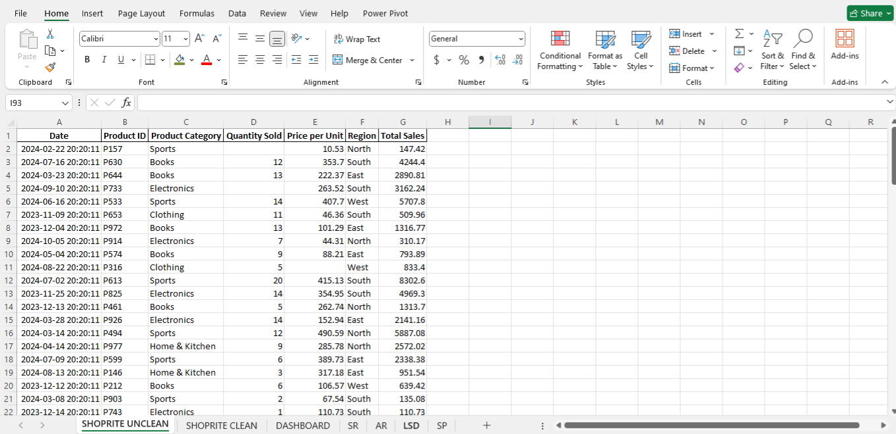
UNCLEAN DATASET ALL GROUP MEMBERS NAME

Slide 5
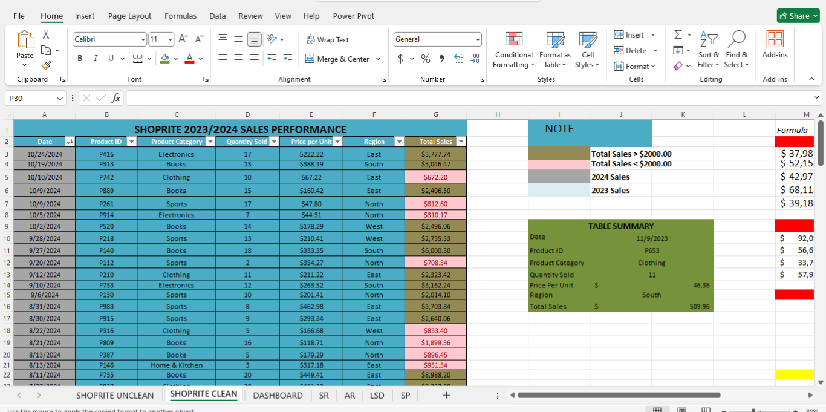
CLEANED DATASET ALL GROUP MEMBERS NAME

Slide 6
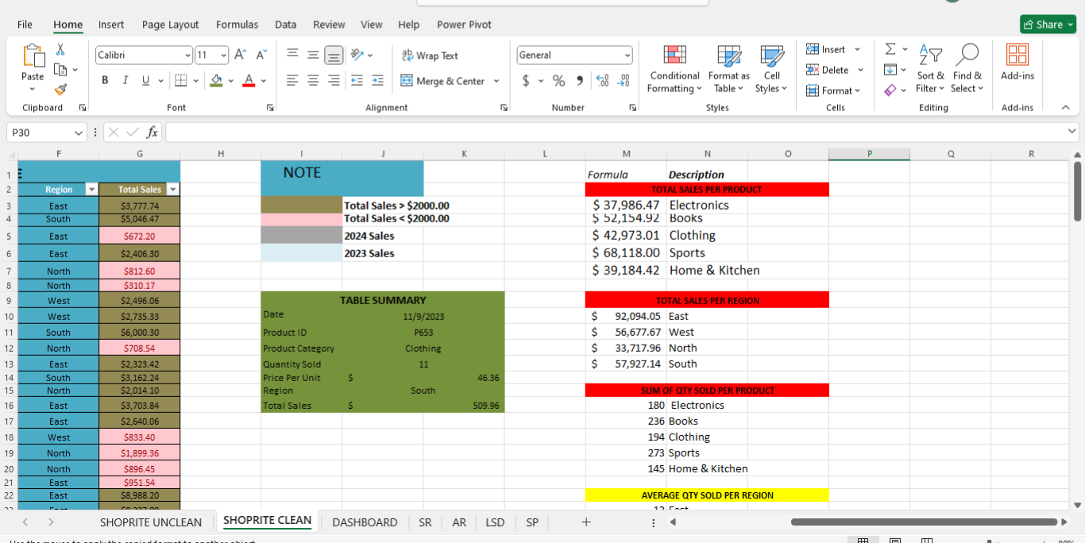
FORMATTING,VLOOKUP & FUNCTIONS ALL GROUP MEMBERS NAME

Slide 7
i
i

Slide 8
i
i

Slide 9
agenda
Introduction
Data Collection
Data Cleaning
Formatting
Vlookup
Dashboard
Summary

Slide 10
o
v

Slide 11
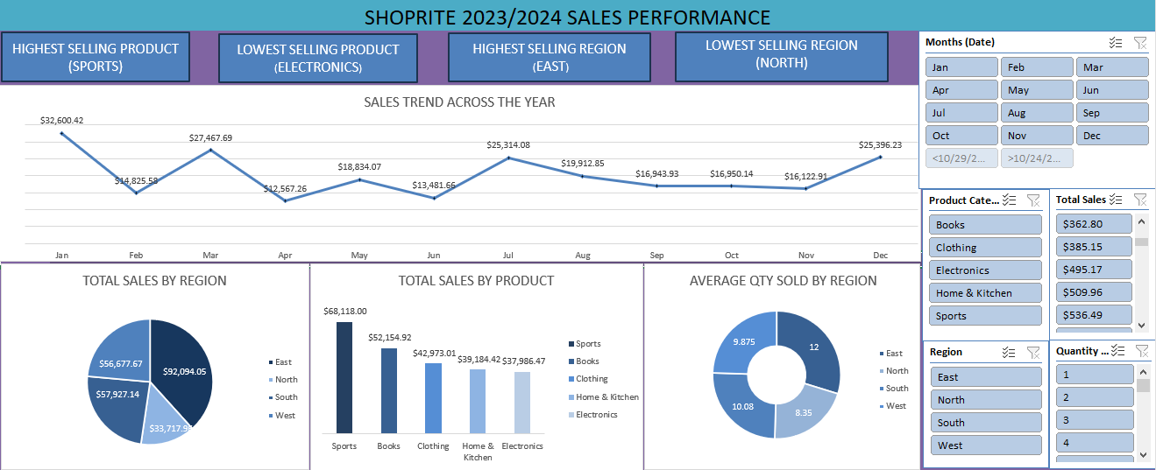
DASHBOARD
Line Chart showing Sales performance across the years.
Column Chart comparing Sales per product category.
Pie Chart comparing Sales per region.
Donut Chart comparing quantity sold out per region.

Slide 12
SUMMARY
Line Chart showing Sales performance across the years.
Column Chart comparing Sales per product category.
Pie Chart comparing Sales per region.
Donut Chart comparing quantity sold out per region.

Slide 13
Thank you!
Any Questions ?

